Slide 1
Groofy Code
Competitive programming platform
Under the supervision of:
Dr. Mohamad Abdelwahab

Slide 2
Agenda
01
02
03
Problem Significance
Project Idea
Project Specifications
04
05
Time Plan
Conclusion
2

Slide 3

Problem Significance

Slide 4

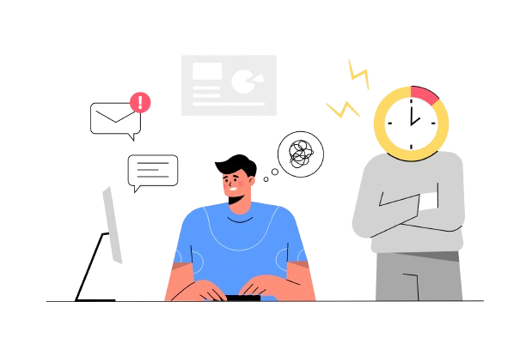
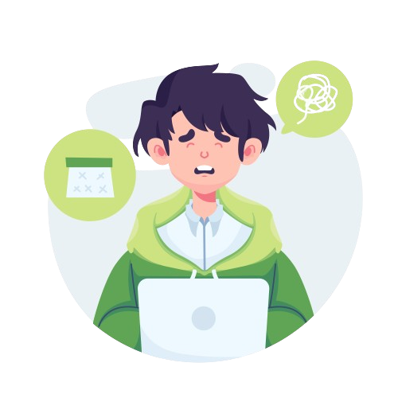
Introduction & Problem Description
Why don’t I know how to implement it ?
Tasks
Deadlines
4

Slide 5

Thinking of the solution
What should I do
1
Should I solve a lot of problems ?
2
Should I solve hard problems ?
3
What time should I spend in solving ?
4
What about challenging people ?
5
Leetcode ? Codeforces ? ….. etc
5

Slide 6
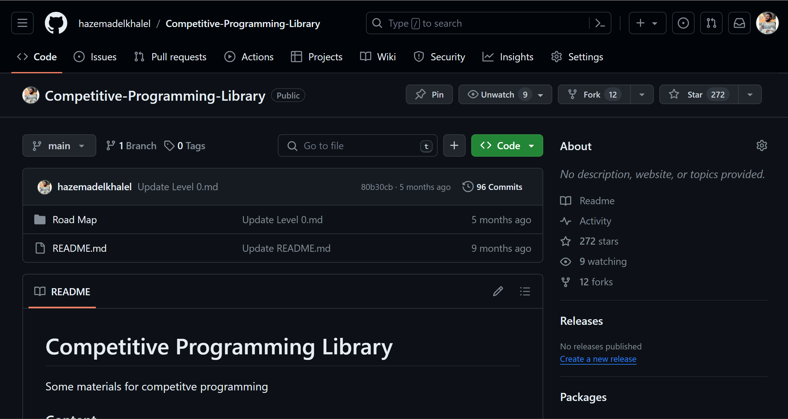

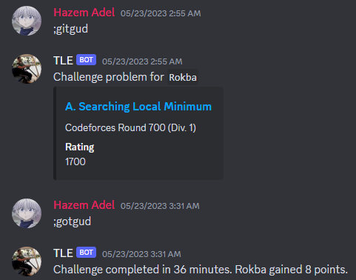
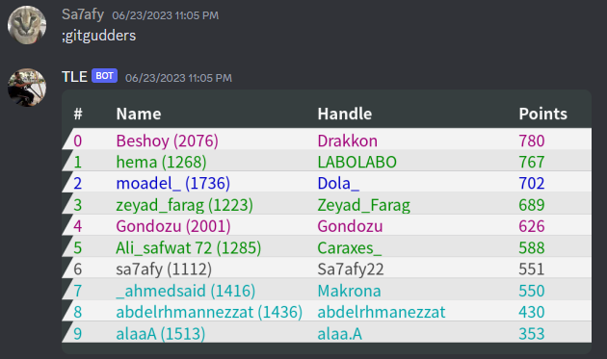
Motivation
Competitive Programming Library
FCAI-ICPC Community
Discord Bot Challenging
Website -> Gaming Platform
6

Slide 7
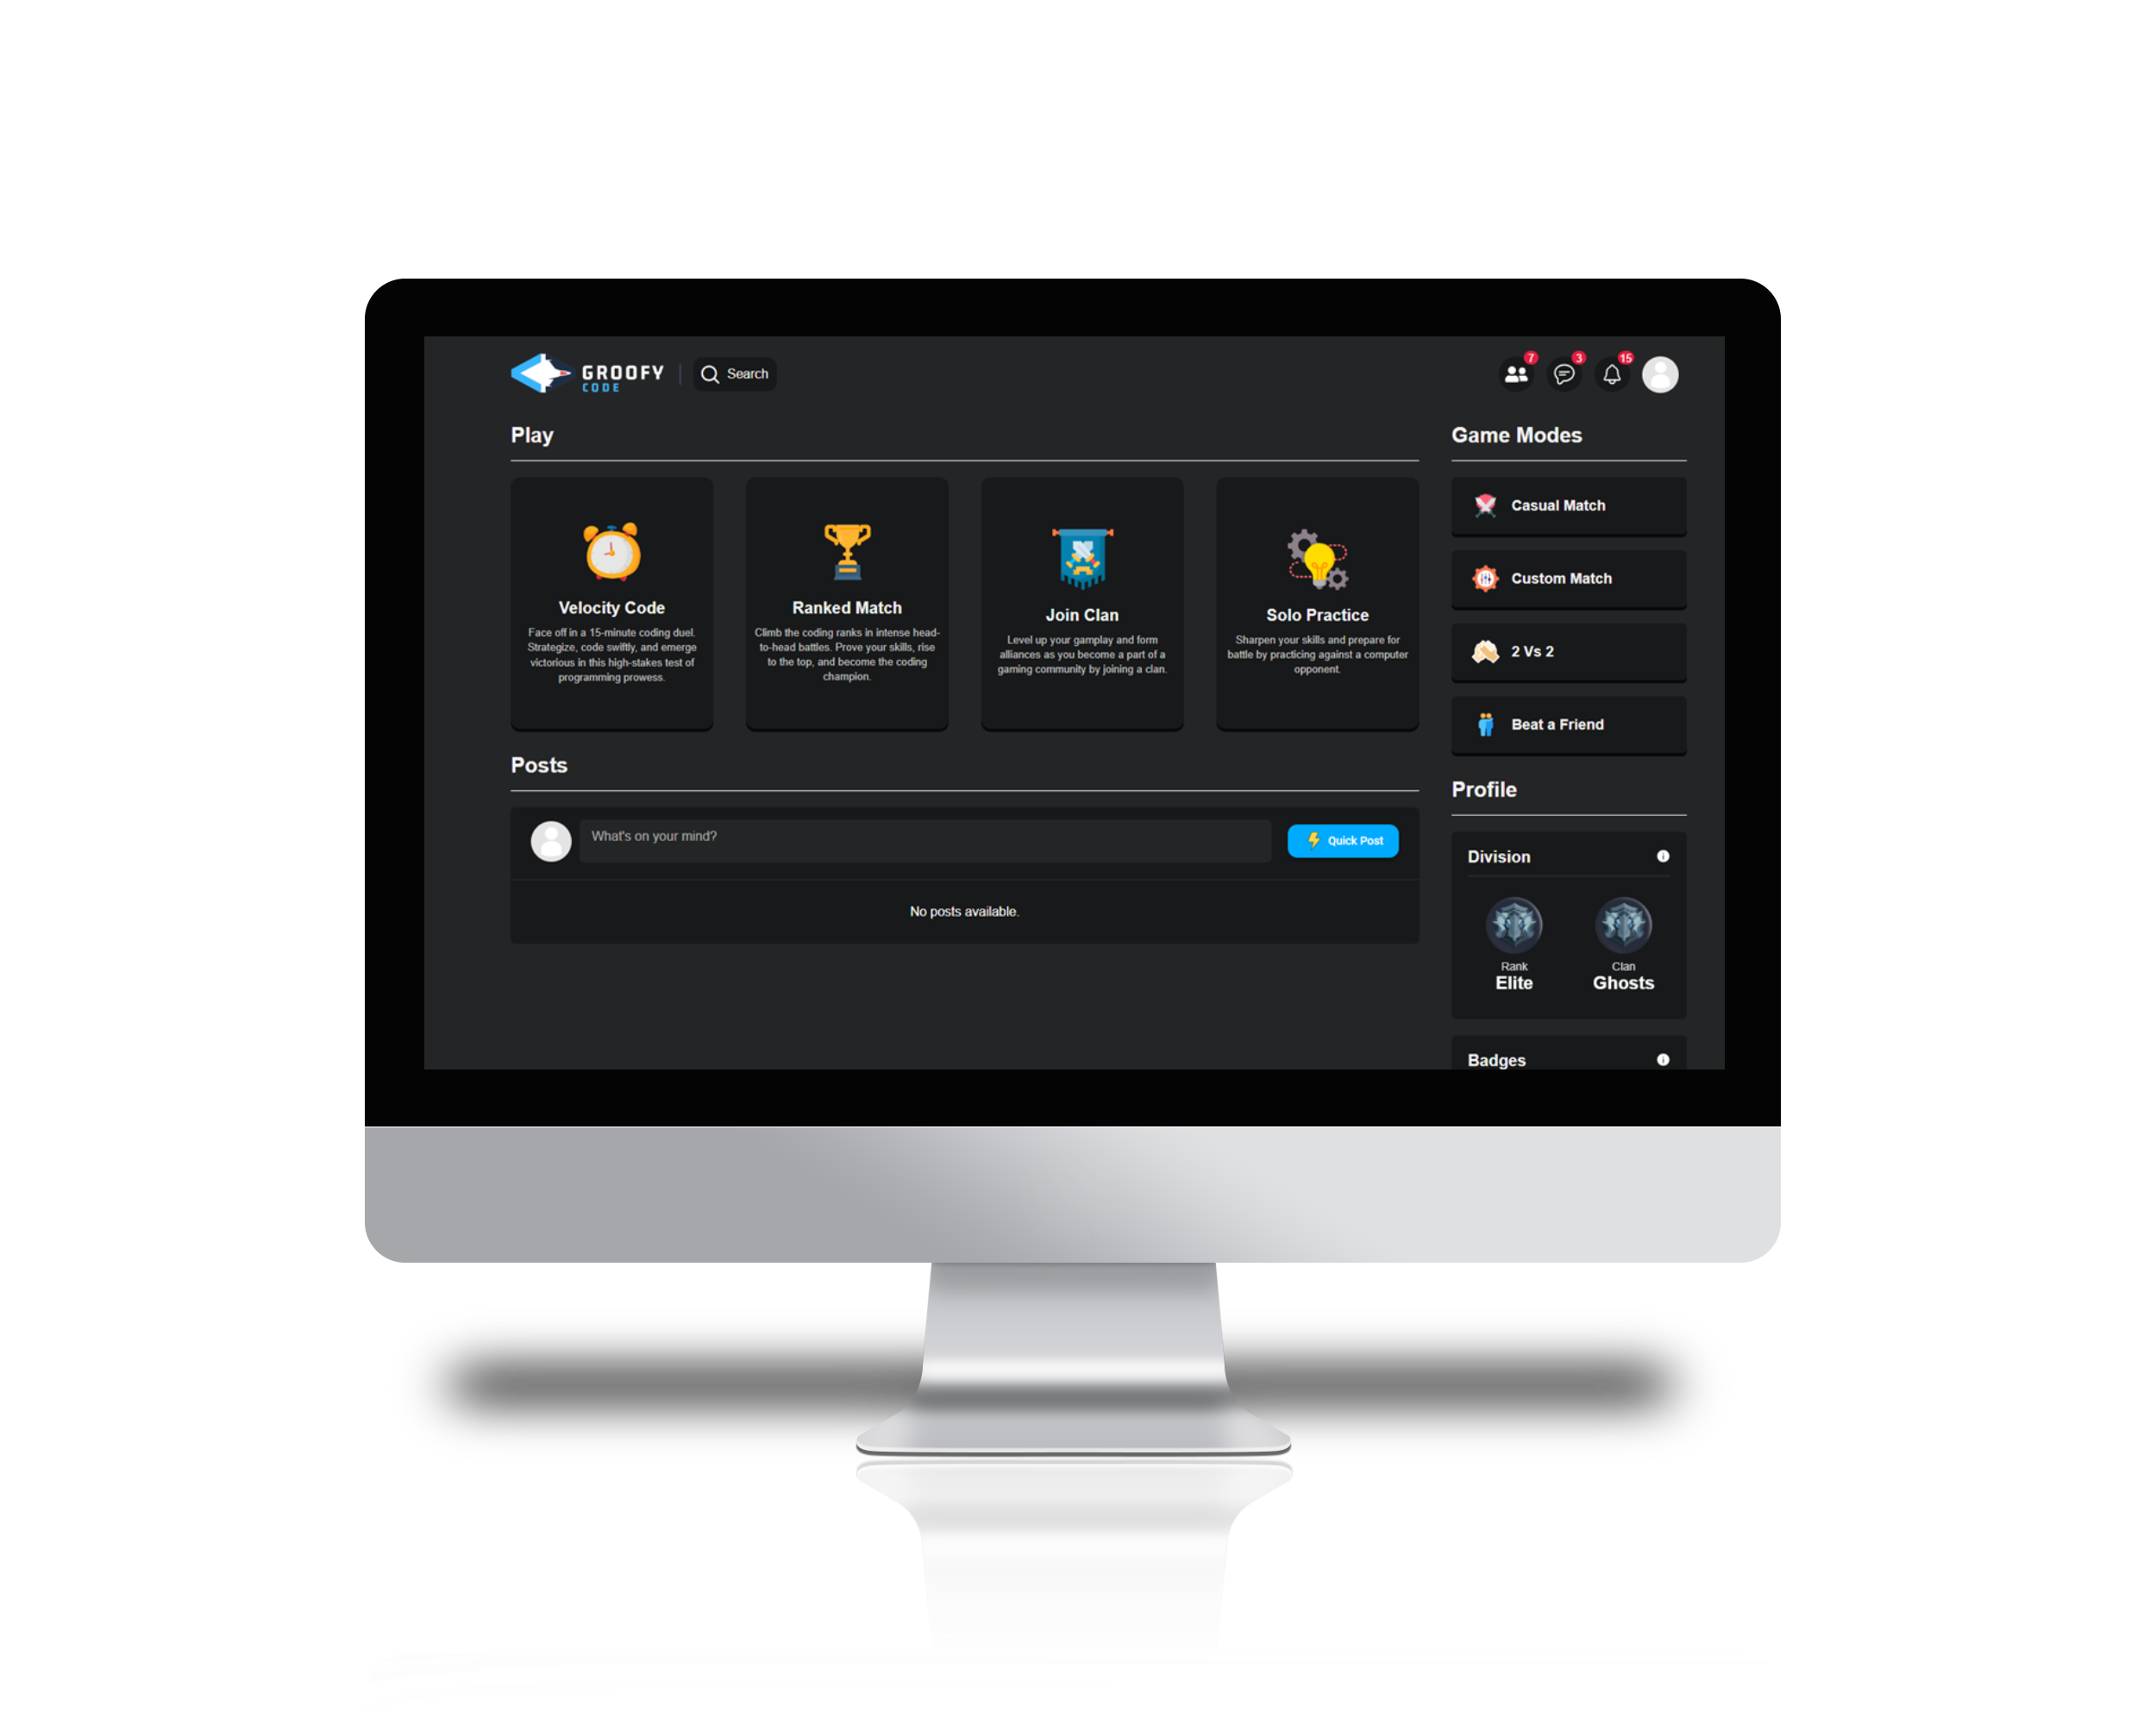
Our Solution: Groofy Code
7

Slide 8
Project Idea

Slide 9
Highlight Features
Challenge Mechanism
Comprehensive User System
Clan Features
Interactive Chat System
9

Slide 10
Match Modes
• Various Coding Challenges
• Difficulty Levels
Click
10

Slide 11
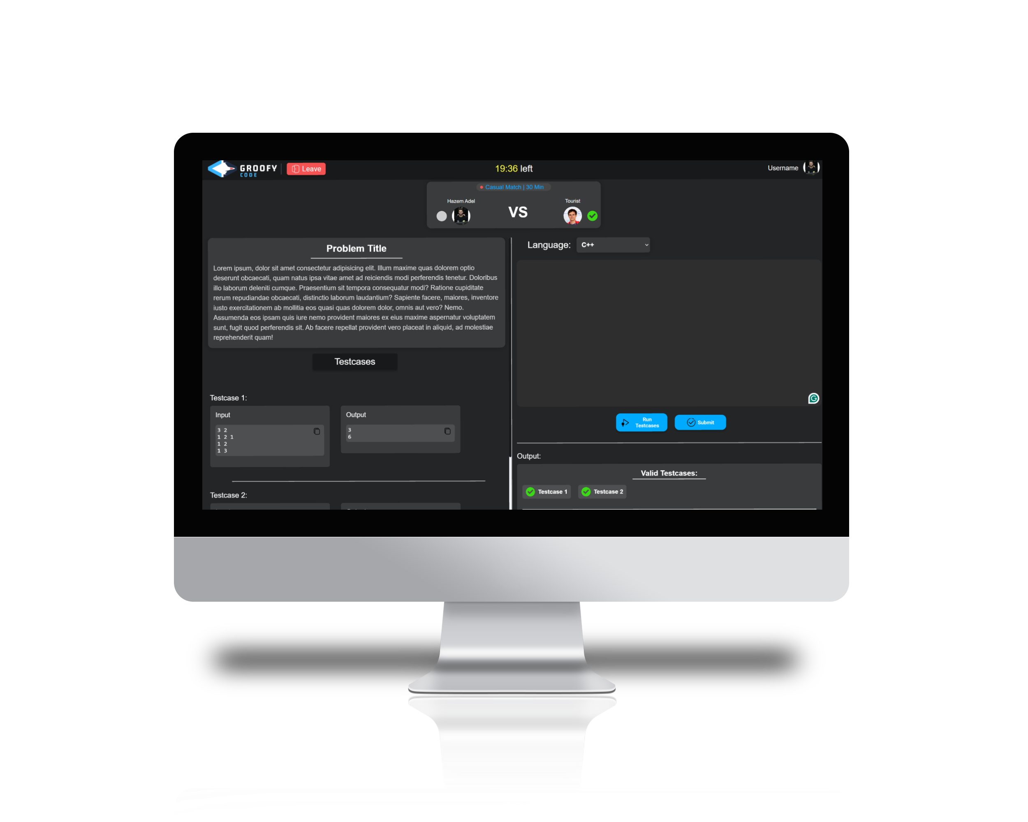
Match Challenge
• Real-time Code Editor
• Submission and Evaluation
11

Slide 12
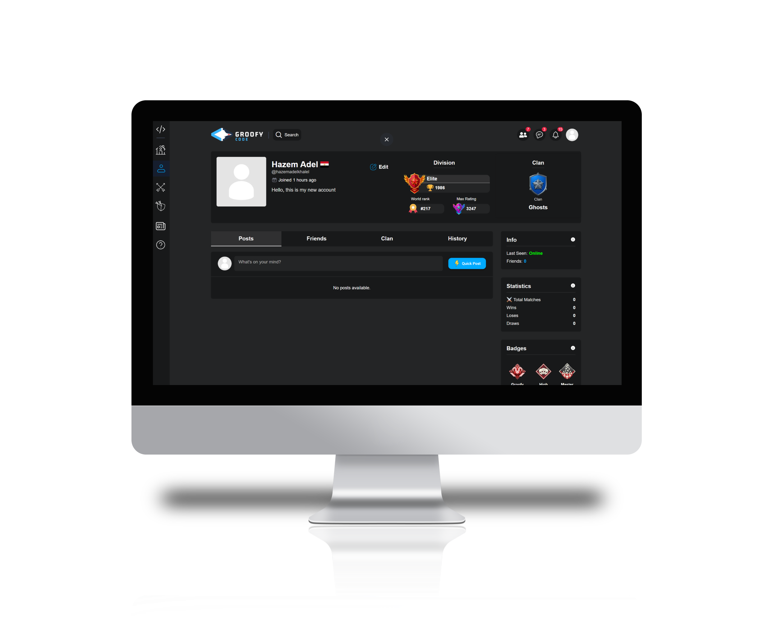
User Profile
• User Registration / Login
• Profile Creation
• Personalized Dashboard
• Insightful User Statistics
12

Slide 13
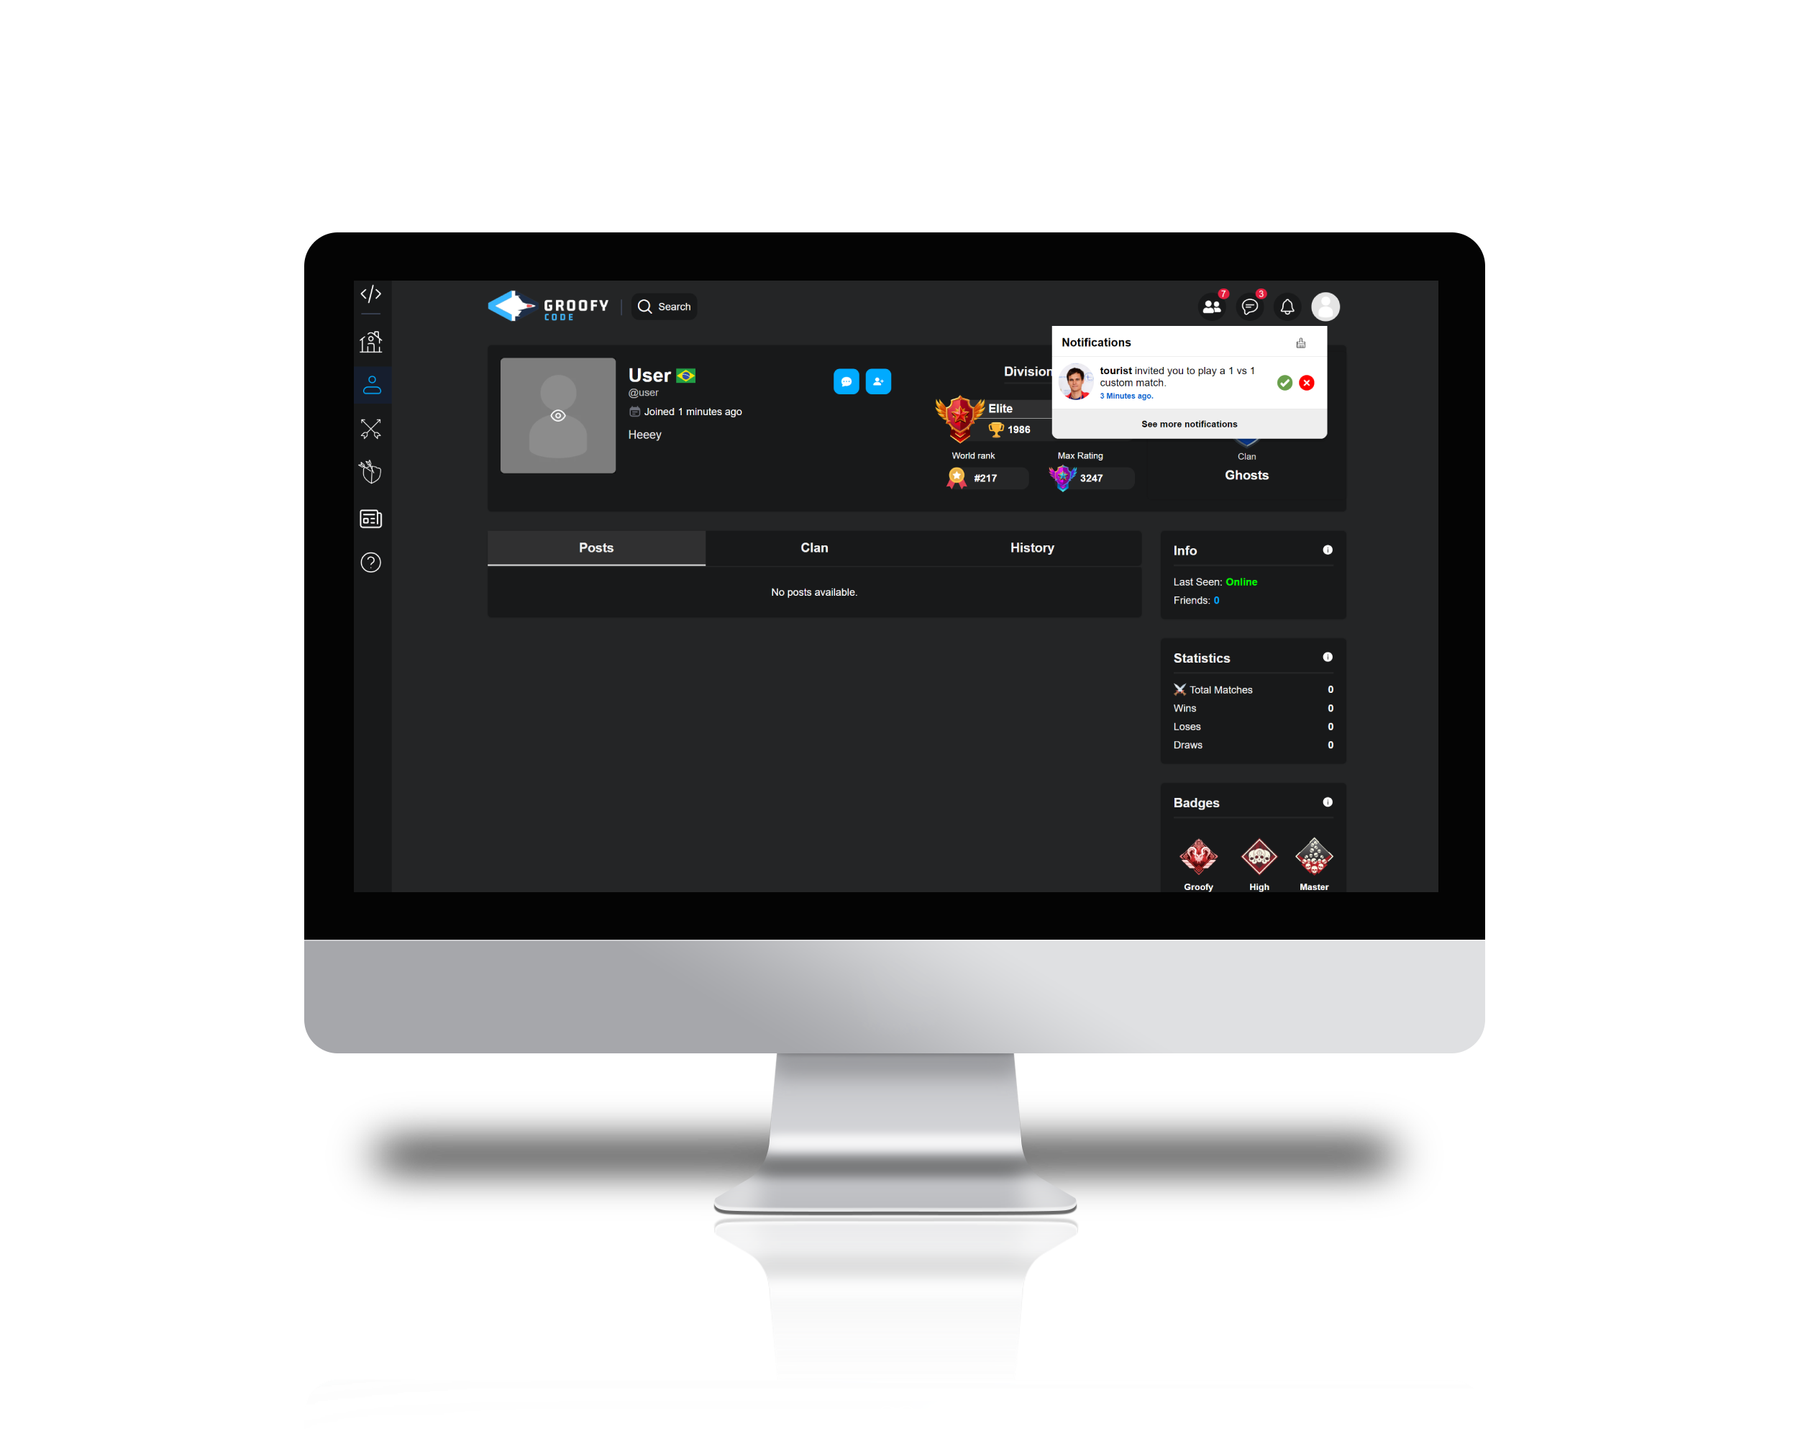
User Interactions
• View users’ profile
• Friend Requests
• Notification system
• Invite a Friend to Match/Clan
• Posts
13

Slide 14
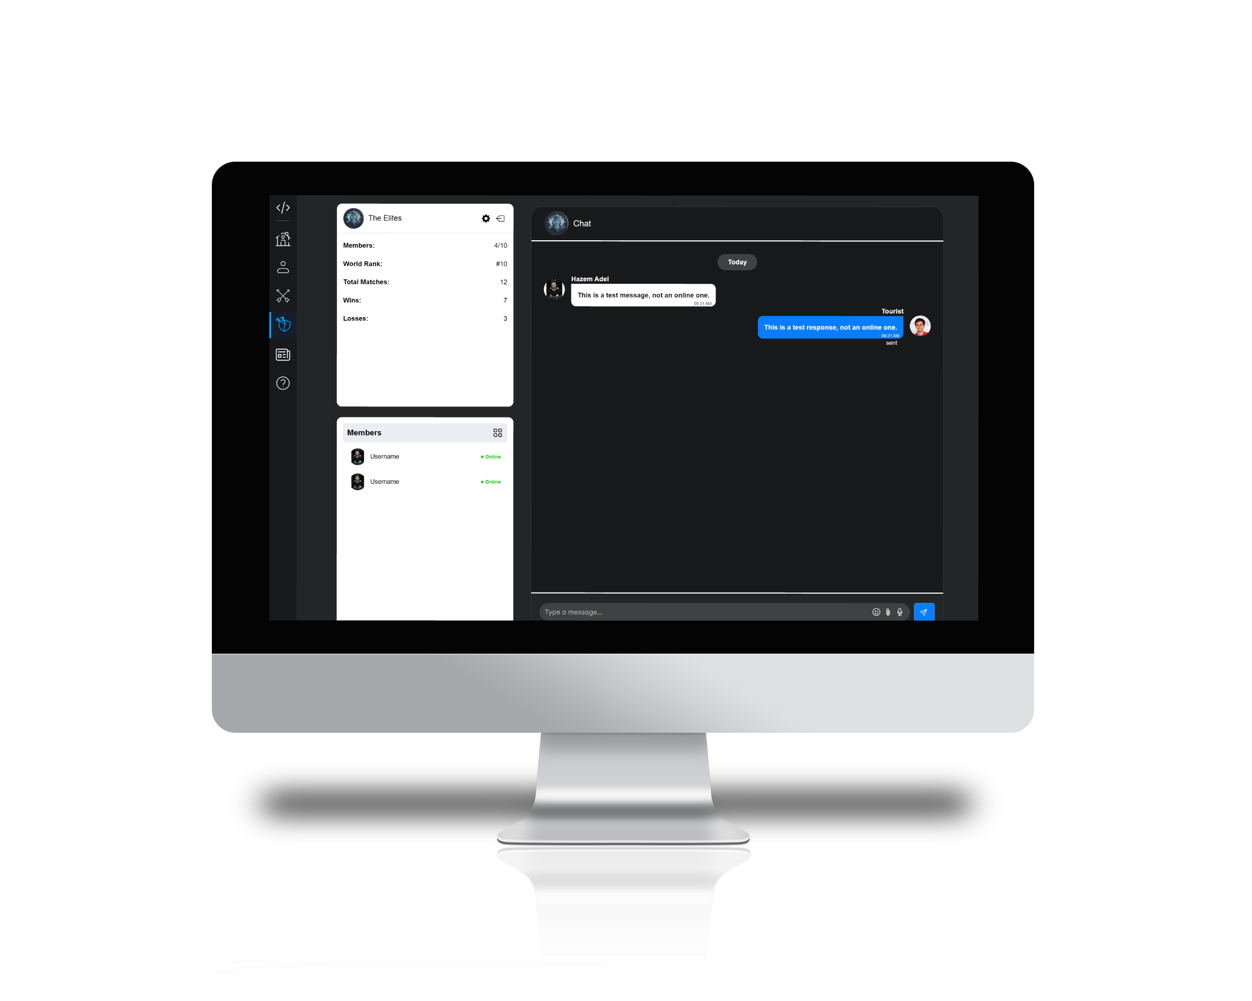
Clan Feature
• Viewing Clan members
• Collaborate with people
• Messaging members
• Play with them
14

Slide 15
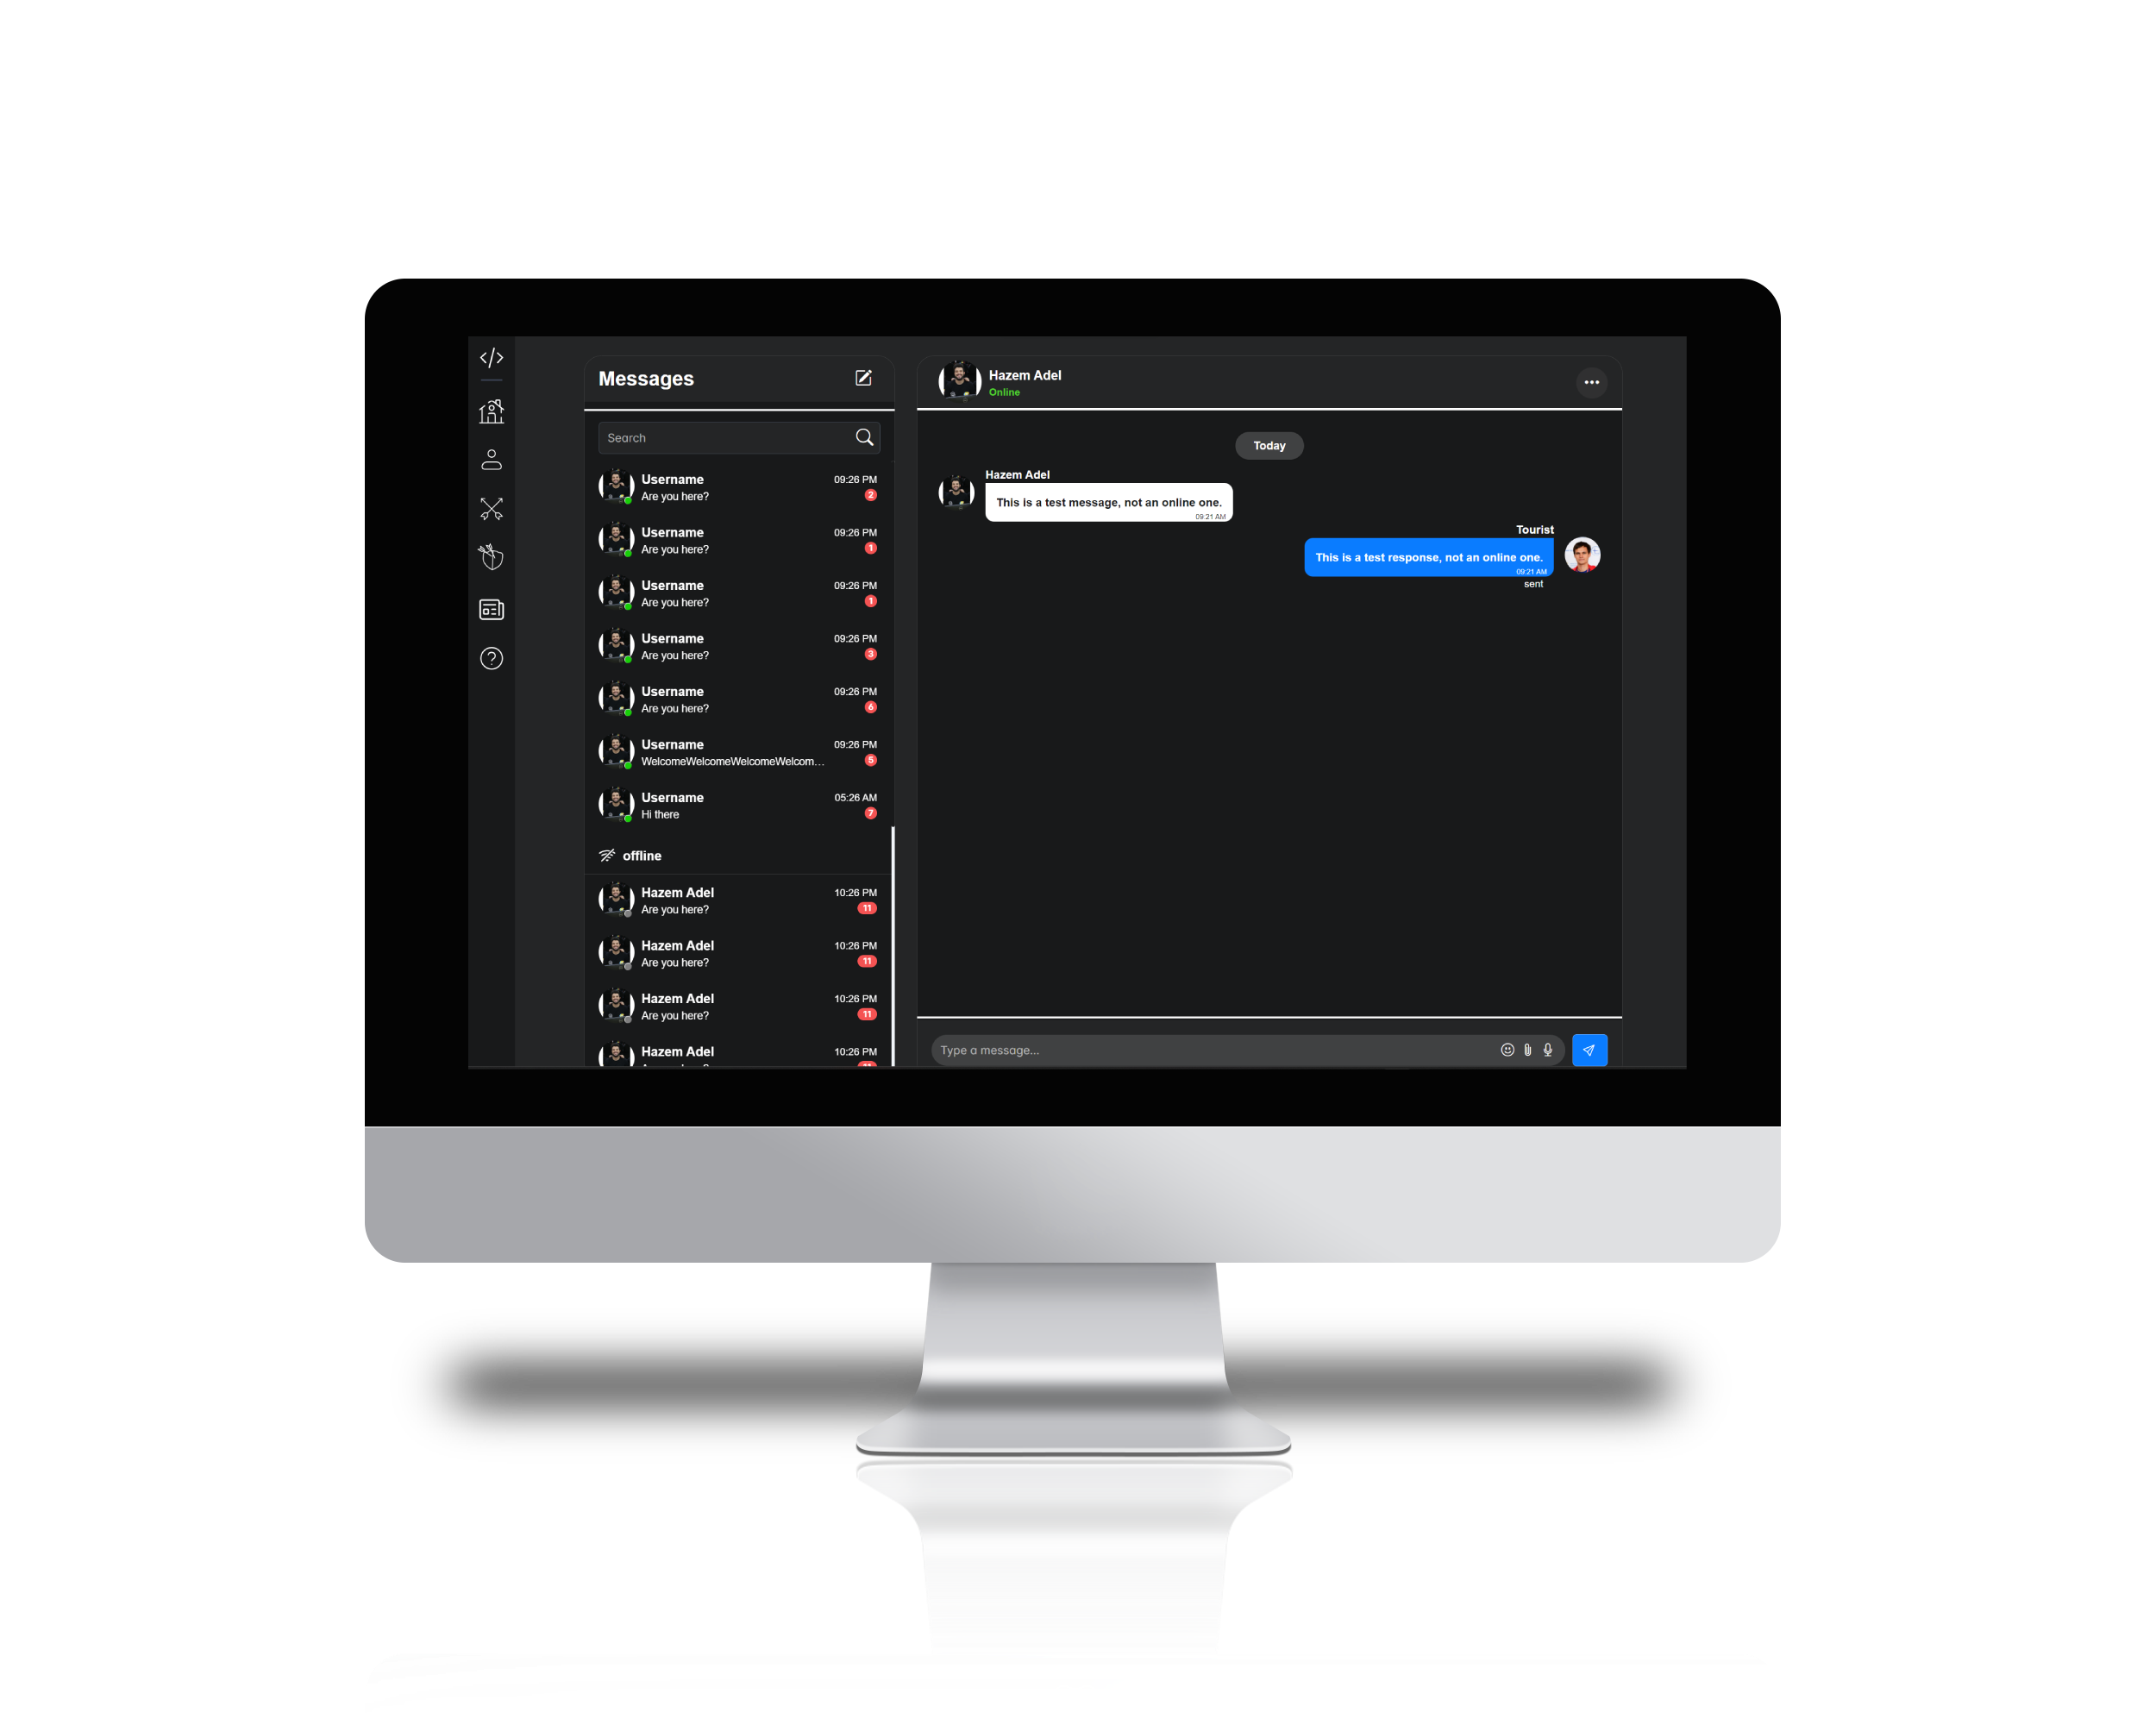
Chat System
• Viewing Friends
• Message a user
• Search for a friend
15

Slide 16
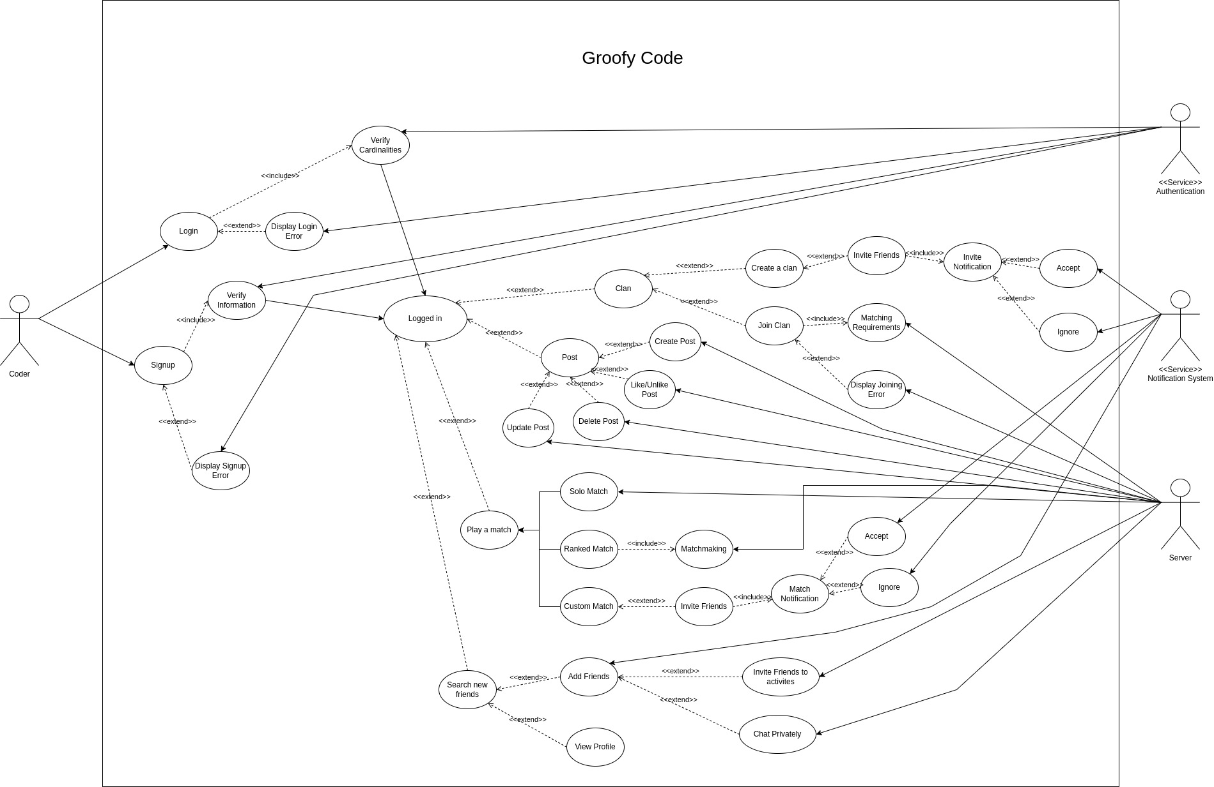
Use Case Diagram

Slide 17
Project Specifications

Slide 18

Architecture
Frontend
Backend
Mongodb
Match Modes
Access Layer
Controllers
User Customization
Base Controller
Clan Community
API
Authentication
Middleware
Coder
Admin
Post
Submission
Chat Interaction
Friendship
Clan
Chat
Message
Search Component
Blog
Problem
Match
….etc.
23

Slide 19

Design Patterns & SOLID Principles
Strategy Pattern
Match Controller
Singleton
Controllers
Abstract Factory
Match with Controller
24

Slide 20
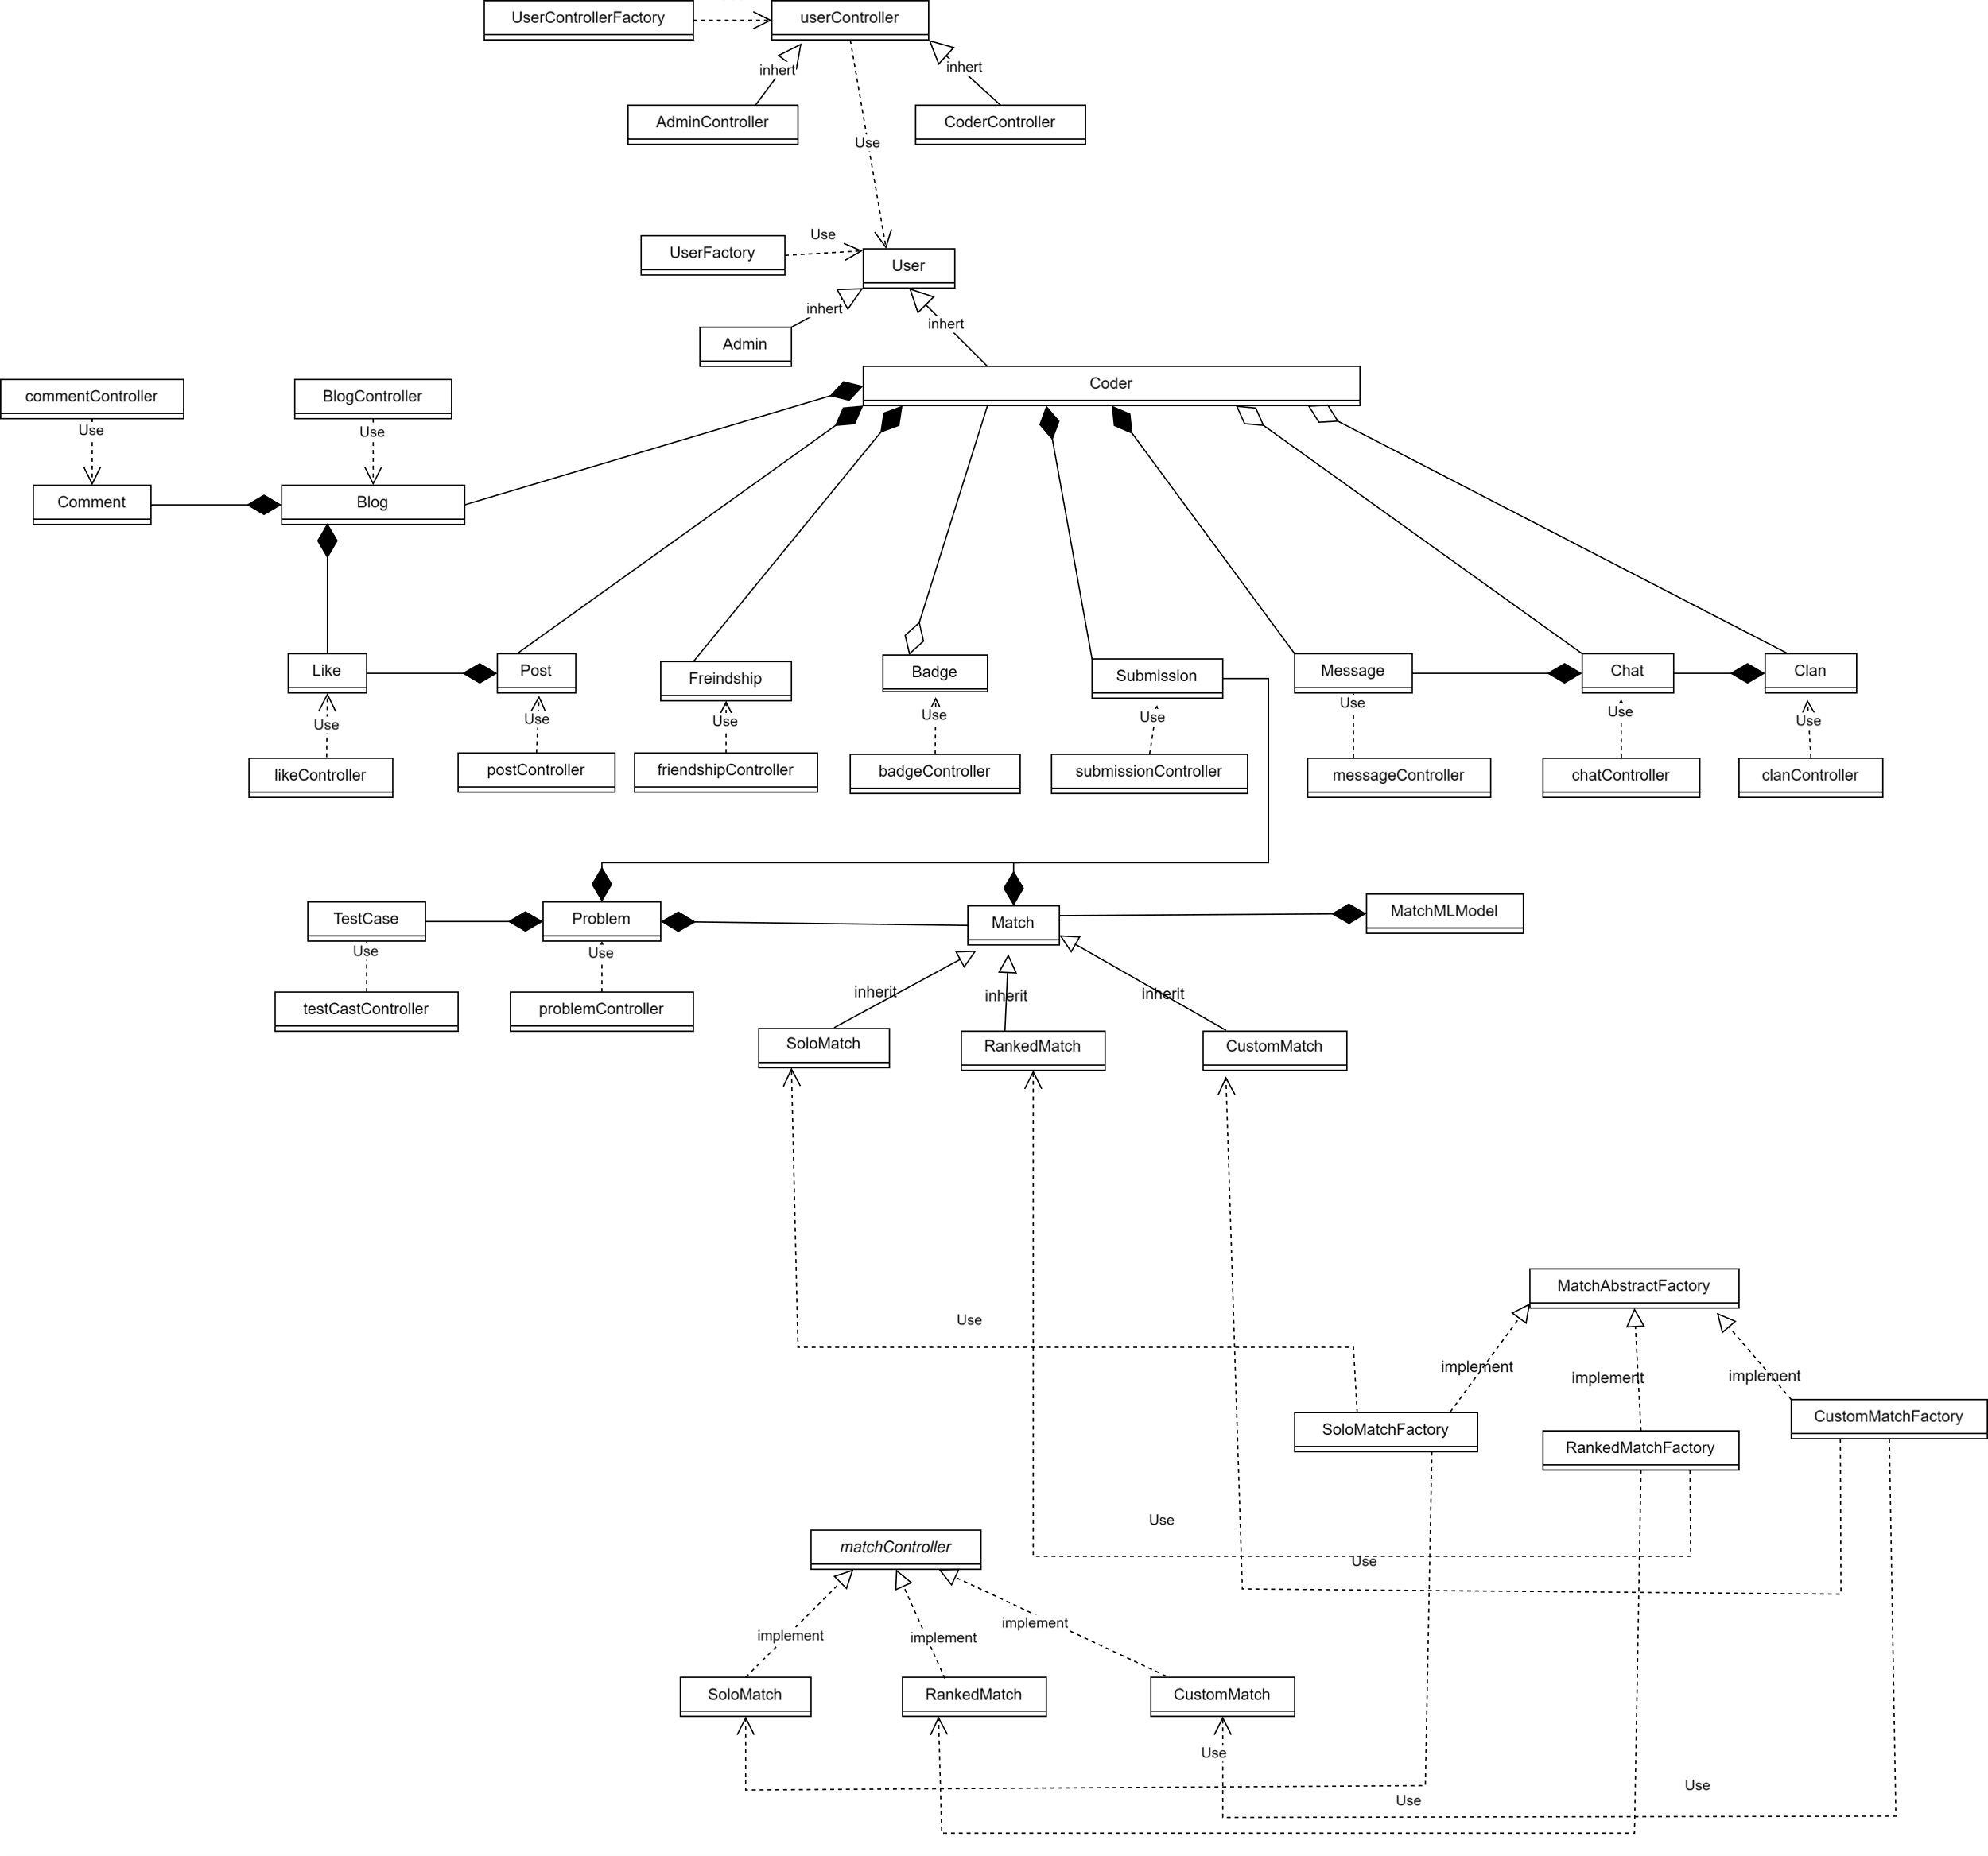
Class Diagram

Slide 21
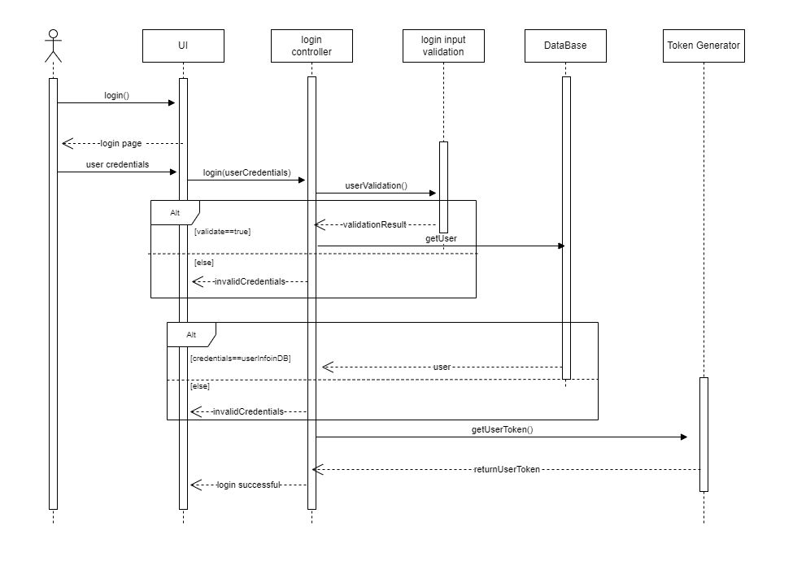
Login Sequence

Slide 22
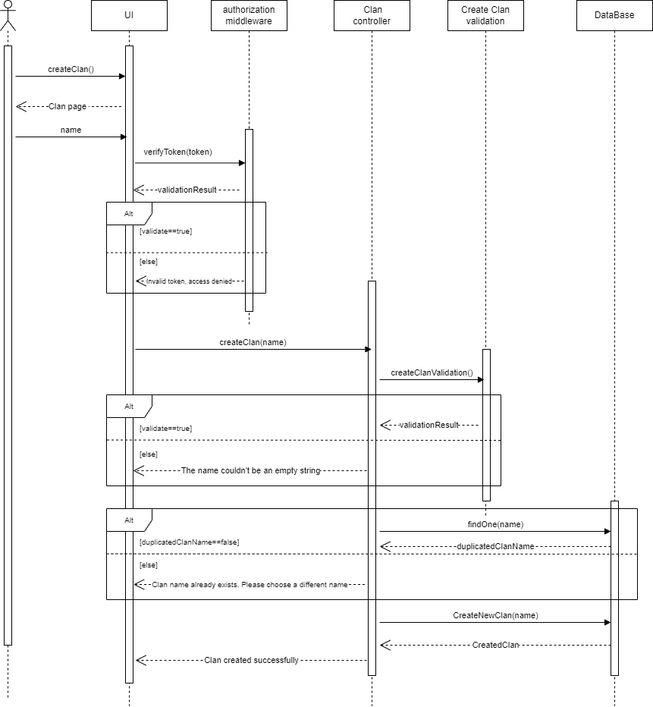
Clan Sequence

Slide 23

Non-Functional Requirements
Scalability
Stable Server
Event-Driven & Non-Blocking I/O Backend
Useability
Friendly User Interface
Portability
Media Queries
Performance
Single Page Application
Caching
25

Slide 24
Traditional
VS
Machine Learning

Slide 25

Why Machine Learning ?
The Slow Improvement Problem
Quantity vs Quality
Reason for Slow Improvement
Finding Suitable Problems for Individual Abilities
Leveraging Machine Learning
Matchmaking Problem
27

Slide 26
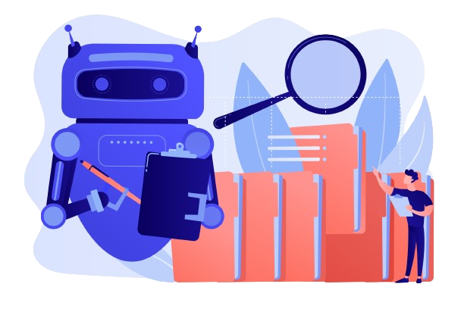
Our Model
Problem Nature
Recommendation System Type
Similarity Scores Metrics and Implementation
Solo Practicing Considerations
Data Collection Methodology
Feature and Target Variables
Model Selection
29

Slide 27











Technologies and Libraries Used
Backend
Frontend
17

Slide 28

Challenges
Lack of hands-on experience with used technologies.
Integration with already existing website such as Codeforces, Codemirror and judge0
Time & Collaboration constraints due to studies and work commitments
Nodejs VS Java Spring boot
21

Slide 29
Time Plan

Slide 30
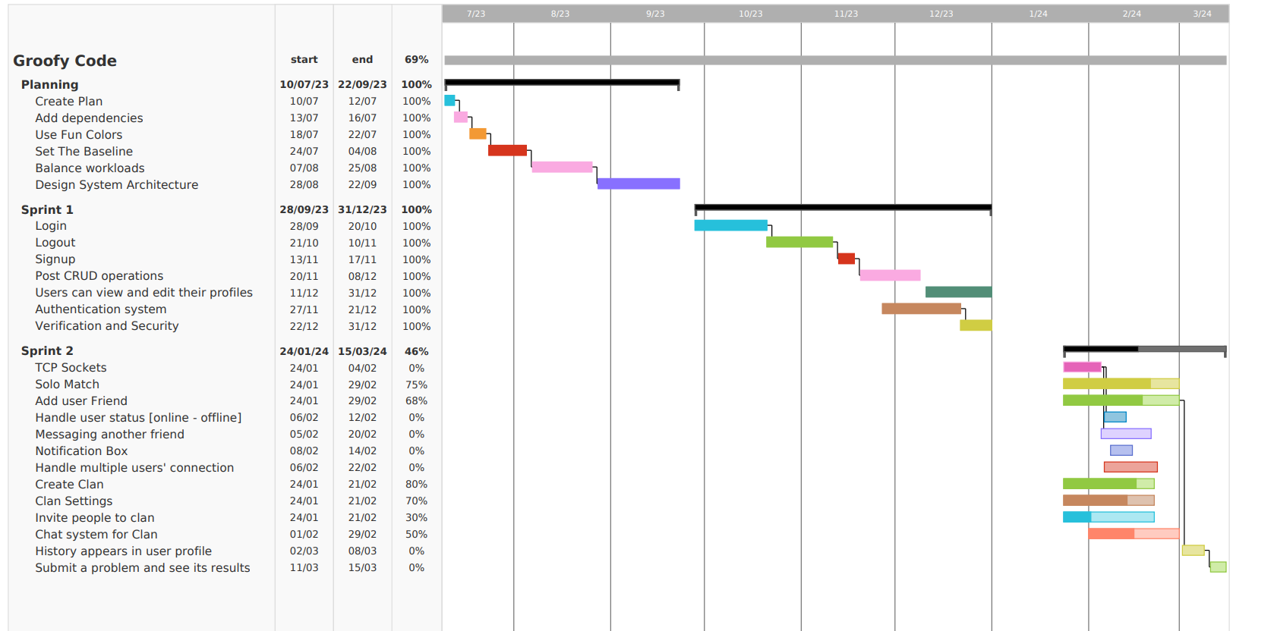
Gantt Chart
19

Slide 31
Conclusion

Slide 32
Conclusion
Groofy Code aims to be a feature-rich and interactive online coding challenge platform.
With a dedicated and skilled development team, we are confident in delivering a high-quality platform that will be a valuable resource for coding enthusiasts.
Encouraging users to improve their coding skills, compete in challenges, and foster a sense of community through clans and social features.
19

Slide 33

Questions ?

Slide 34


